Slide 1
Computer Vision
Technical Content

Slide 2
SimpleCV
Overview
SimpleCV is an open source computer vision library that can implement OpenCV without a high learning curve.
Built in commands allow the use for display augmenting, image/video processing, object tracking, color mapping, color manipulation, data storage and extraction, ect.
We implement this library into python scripts.

Slide 3
Object Tracking

Slide 4
Object Tracking
Combined object tracking techniques
Blobs
The blobs command is a predetermined script that allows for object detection.
By implementing this command we do not have to re-invent the wheel.
Ability to detect different geometric shapes, color, edges, data each blob contains.
Camera/Display
Allow the use to open and manipulate video through display
Image Processing
HSV and RGB color schemes
Historgrams
Image segmentation

Slide 5
Color Mapping/Manipulation
RGB Color Scheme
Theory every image contains Red, Green and Blue fundamental colors.
Pixelated and mapped on screen with Red, Green and Blue pixels values
RGB in SimpleCV
By importing simpleCV into our base code we can segment images into RGB components.
Pushing back color in correlation with our object detection can allow us to segment our object and attain coordinates of the individual object minus its surrounding.

Slide 6
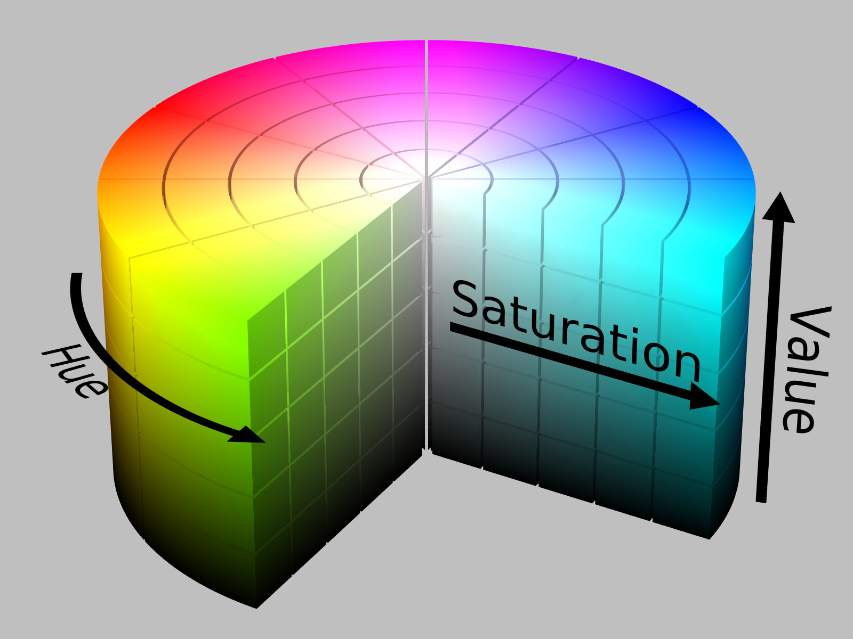
Color Mapping/Manipulation
HSV Color Scheme
Hue, Saturation, Value
Hue = Color in General
Saturation = Presence of White
Value = Brightness of Color
HSV unlike RGB allows for a wider range of color and manipulation
No need to segment using Red, Green and Blue. We can use direct values of color.
HSV can be directly implemented and imported into python script using simpleCV.

Slide 7
Design and Testing Options
Controlled conditions
Perfect light
Background
Color of object
Testing RGB vs. HSV
Histograms = Map of image in pixel values
Testing Object Tracking through the use of visual effects.
Set color scheme to gray scale to perfect object detection.
Saving Coordinates of objects to text file

